Slide 1

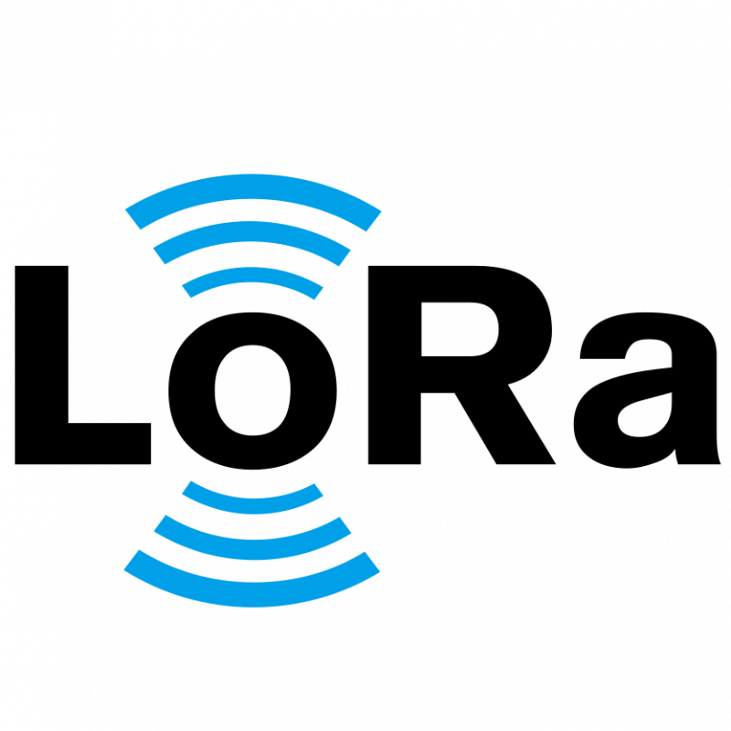
RF Technology
Dr. D. Y. Patil Institute of Technology
Under the Guidance of : Dr. D. G. Bhalke
By.Prateek Singh
Date:13/05/2025
Notes:
(Blue)
Paul G. Allen School of Computer Science and Engineering, UW

Slide 2
Motivation
Design
Hardware Implementation
Results
Conclusion
References
Challenges & Future Work
Notes:
(Blue)

Slide 3
Motivation: Ubiquitous Connectivity
Implementing communication between billions of devices
Requirements
Reliable and long range communication
Low power
Inexpensive to manufacture
Issues
No existing technology combines all three factors
E.g., backscattering is low power and cheap, but short ranged
Solution
LoRa

Slide 4
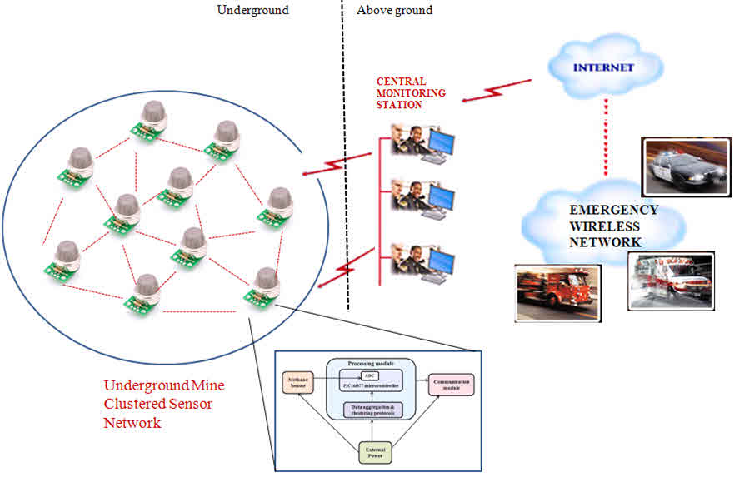
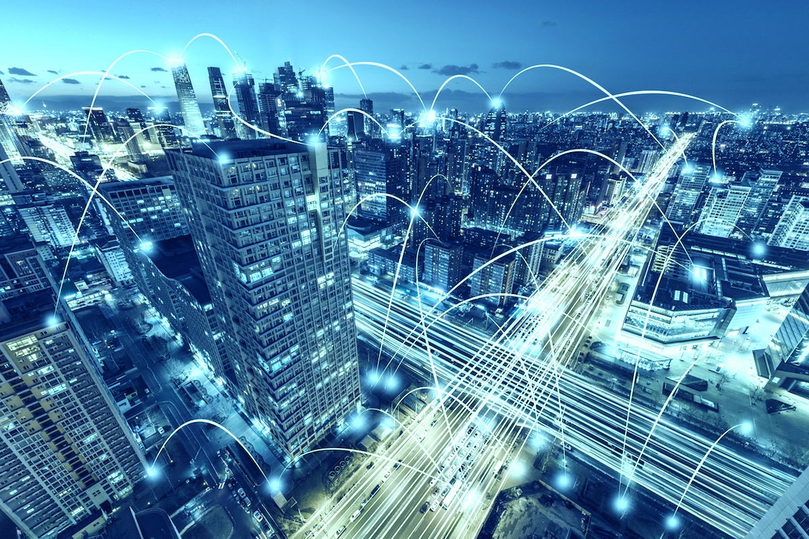
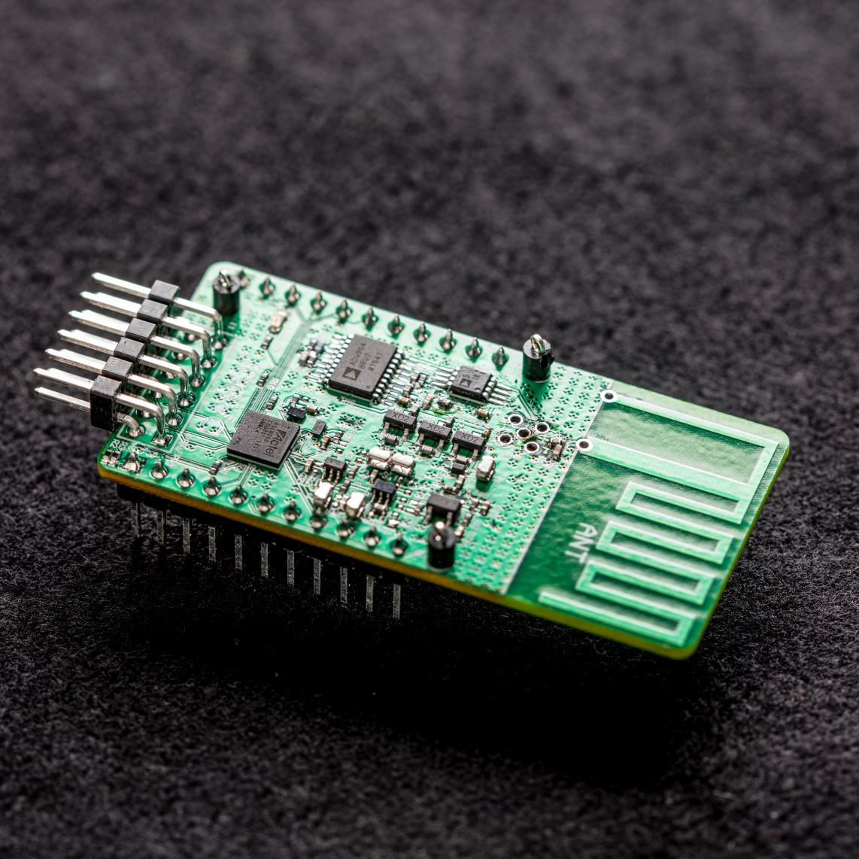
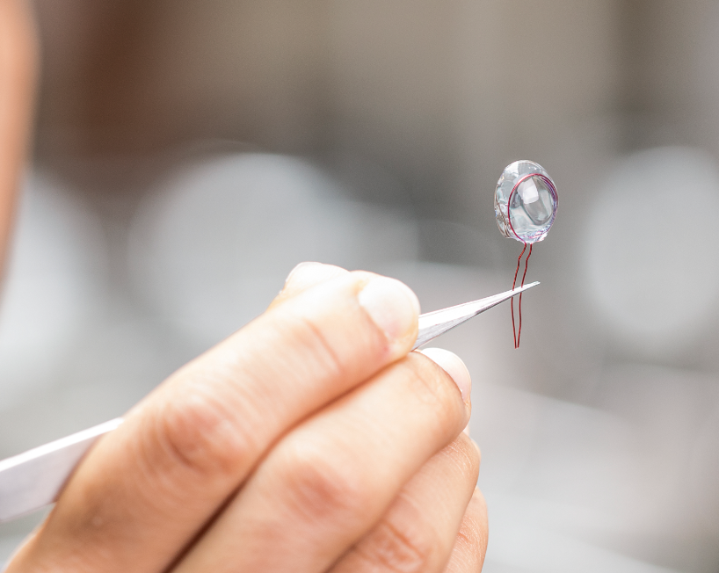
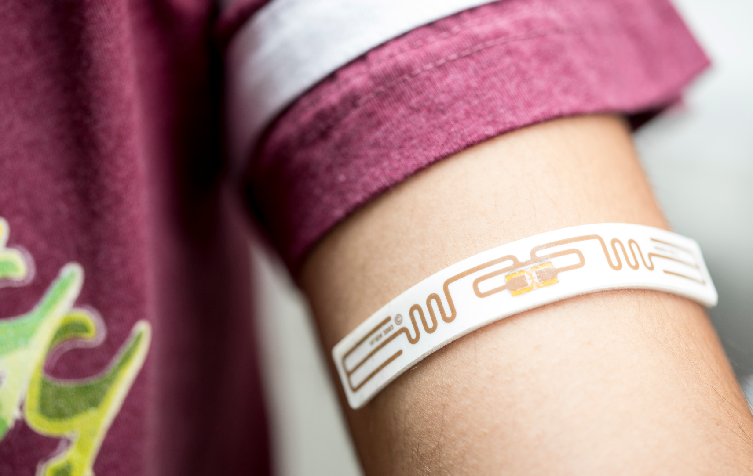
Applications
Smart cities
Precision agriculture
Whole-home and office sensing
Body-mounted medical sensing
Images courtesy of longrange.cs.washington.edu

Slide 5
Motivation
Design
Hardware Implementation
Results
Conclusion
References
Challenges & Future Work

Slide 6
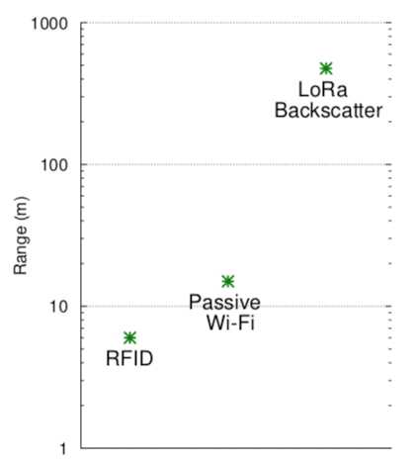
Why LoRa ?
Advantages:
Low power consumption (three orders of magnitude lower than radios; not significantly better than other backscatter modes)
High operating range (100s of meters compared to tens for other backscatter modes)
Low cost and size (primarily digital construction materials)
Alternatives Explored:
Radios
Wi-Fi
BLE
ZigBee
SigFox
Backscatter
RFID
Passive Wi-Fi
Notes:
(Blue)

Slide 7
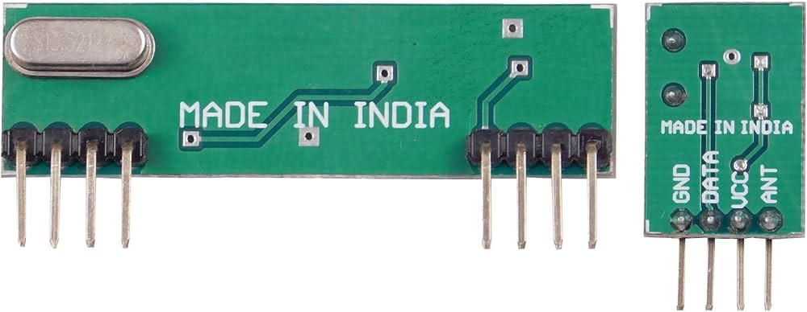
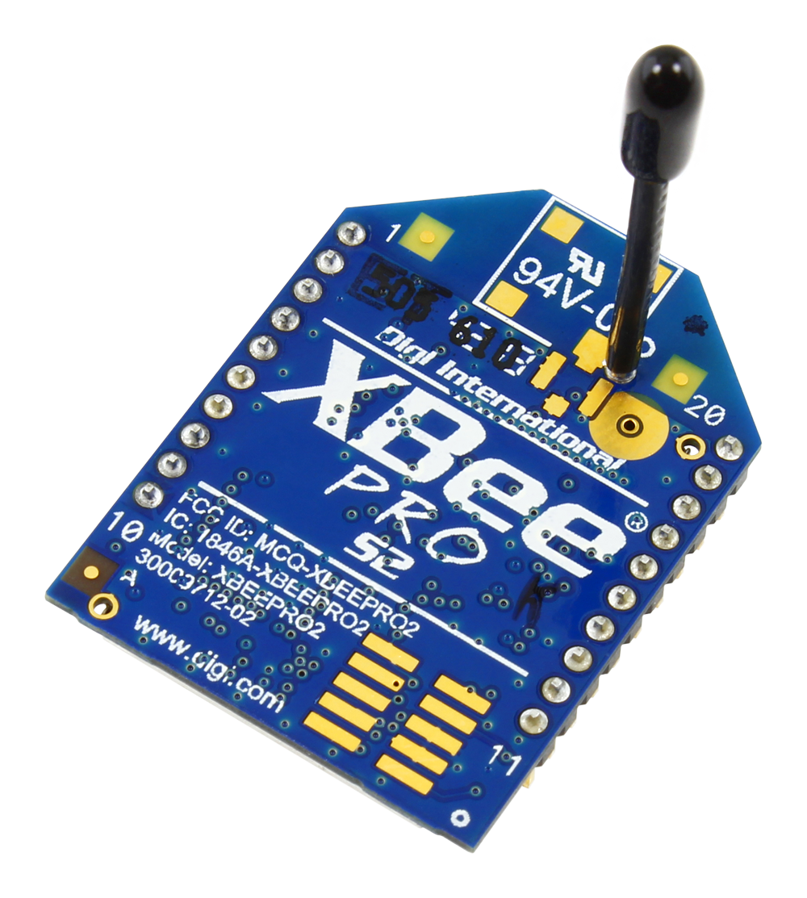
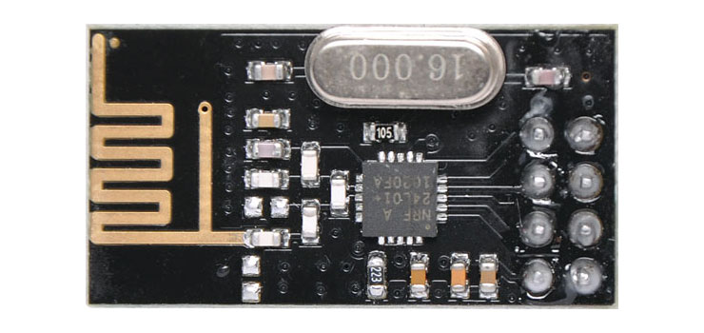
RF Module
RF zigbee Module
RF NRF Module
Low Power Consumption.
Easy For RF-based Application.
Complete Radio Transmitter.
Transmit Range Up To 50m.
CMOS / TTL Input.
Voltage: 3-3.6V (recommended 3.3V).
Maximum output power: +20dBm.
Power-down mode current: 4.2uA.
Operating Range: 1Km
Receive Mode Current(peak): 45mA
It uses 2.4GHz global open ISM band.
Integrated, Wire Antenna
Interoperable other ZigBee-compliant devices
15 general-purpose I/O lines
Industry-leading sleep current of sub 1 µA
Transmit Range Up To 1km.
Notes:
(Blue)

Slide 8
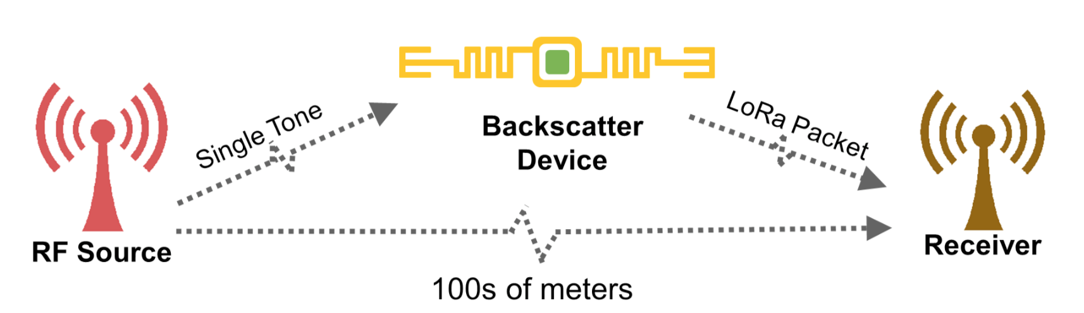
Why LoRa ?
Notes:
(Blue)

Slide 9
LoRa Architecture
The LoRa wireless uses a chirp-spread spectrum (CSS) modulation with options for different Spreading Factors (SF) and bandwidth to optimize the modulation to meet the range and data requirements.
LoRa uses ISM bands 433MHz, 868MHz or 915MHz depending on jurisdiction with the band divided up into channels.
LoRa network consists of several elements. Most of the modern LoRa IoT LAN technologies use mesh network architecture.
LoRa Nodes/ End points
LoRa Gateways
Network servers
Application server
Notes:
(Blue)

Slide 10
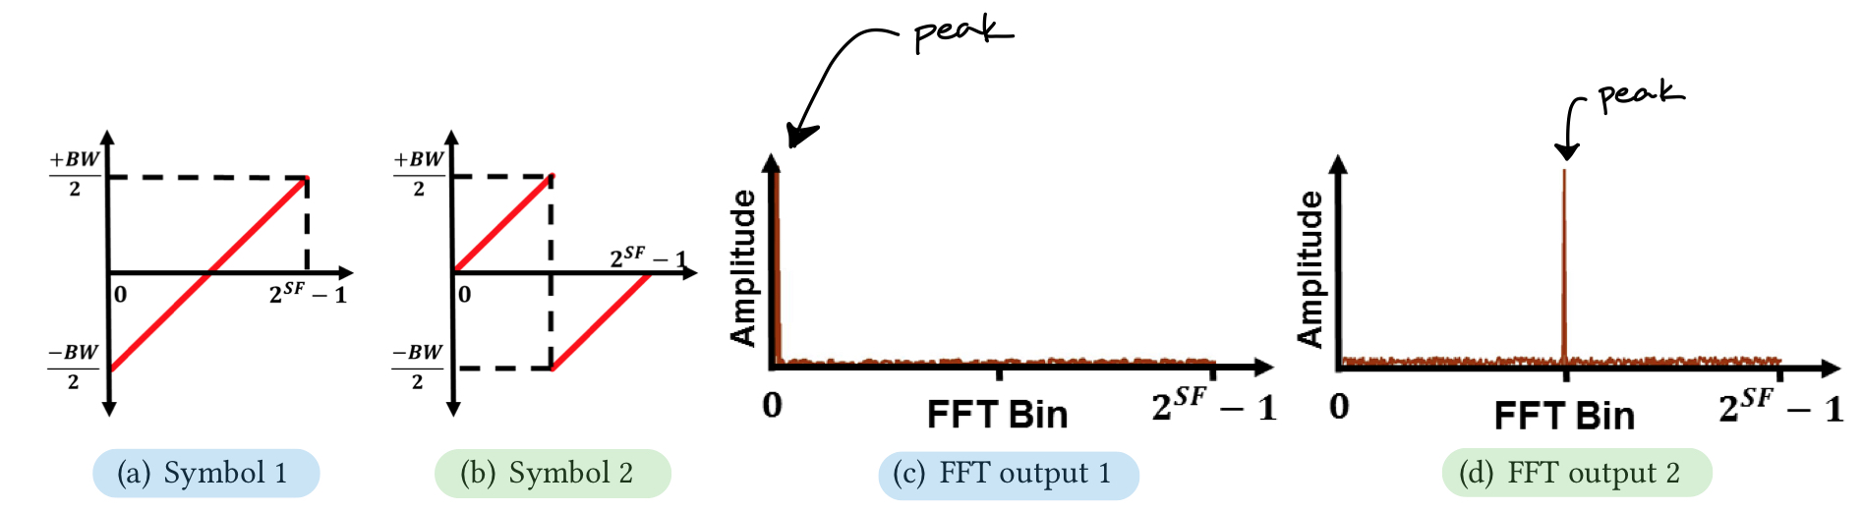
Synthesizing CSS with Backscatter
Recall: Chirp spread spectrum (CSS) encodes data as cyclic time shifts of the baseline “chirp,” which appear as frequency shifts after an FFT.
Notes:
(Blue)

Slide 11
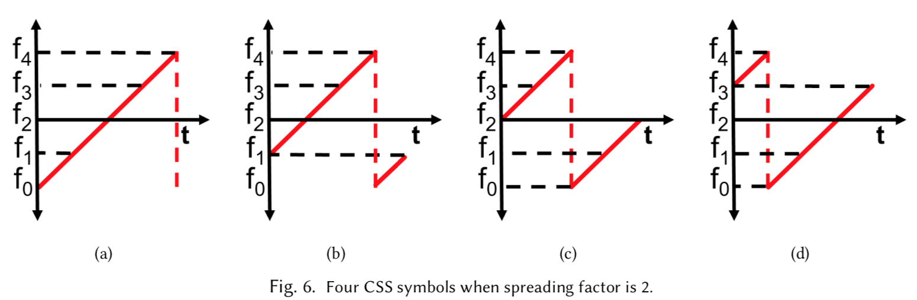
Synthesizing CSS with Backscatter
Recall: Chirp spread spectrum (CSS) encodes data as cyclic time shifts of the baseline “chirp,” which appear as frequency shifts after an FFT.
Bit rate: BW/(2^{SF})•SF (BW = bandwidth; SF = spreading factor)
Notes:
(Blue)

Slide 12
Backscatter Harmonic Cancellation
Issues in signal approximation with square waves
Creates mirror copies at third and fifth harmonics
Prior systems ignored these signals (out-of-band)
Noisy for LoRa due to high sensitivity
Solution
Use different signal than a square wave
Square waves have two voltage levels → high frequency components
Multilevel signal to better approximate sinusoid
Designed such that third and fifth harmonics are cancelled

Slide 13
Reverse-Engineering LoRa Packet Structure
Challenge: physical layer specification for LoRa is proprietary
Solution:
Reverse-engineer LoRa physical layer using Semtech patents
Analyze transmissions from LoRa chipsets on a Universal Software Radio Peripheral (USRP)
Notes:
(Blue)

Slide 14
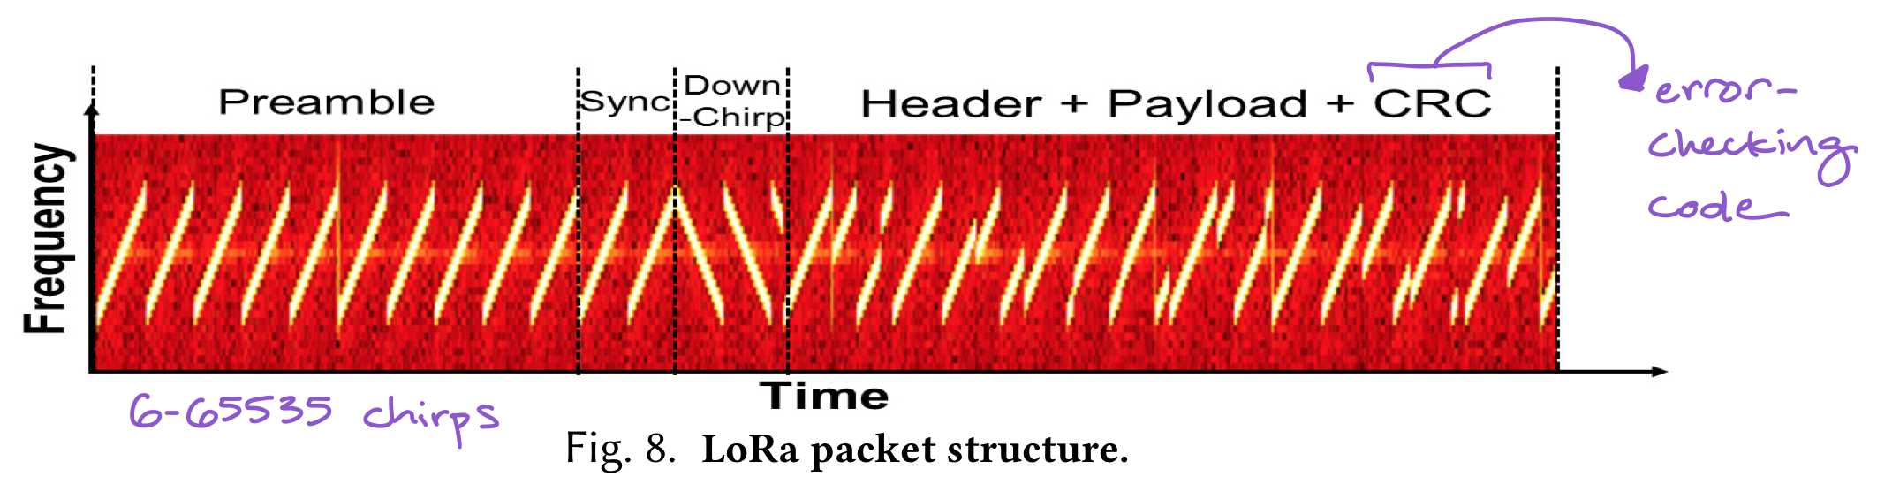
Reverse-Engineering LoRa Packet Structure
Challenge: physical layer specification for LoRa is proprietary
Solution:
Reverse-engineer LoRa physical layer using Semtech patents
Analyze transmissions from LoRa chipsets on a Universal Software Radio Peripheral (USRP)
Notes:
(Blue)
CRC = cyclic redundancy check (an error-detecting code)

Slide 15
Setting LoRa Parameters
LoRa bit rate determined by 3 factors:
chirp bandwidth
spreading factor
error correction coding rate
BW and SF set in advance, known by transmitter & receiver
High sensitivity: phase of chirps must change continuously with time and have same value at each end of chirp
At each frequency, increase phase by 2𝜋/SF
To comply with FCC, frequency-hop the single-tone chirp transmitter
Backscatter device continues to be offset by Δf
Notes:
(Blue)

Slide 16
Motivation
Design
Hardware Implementation
Results
Conclusion
References
Challenges & Future Work

Slide 17
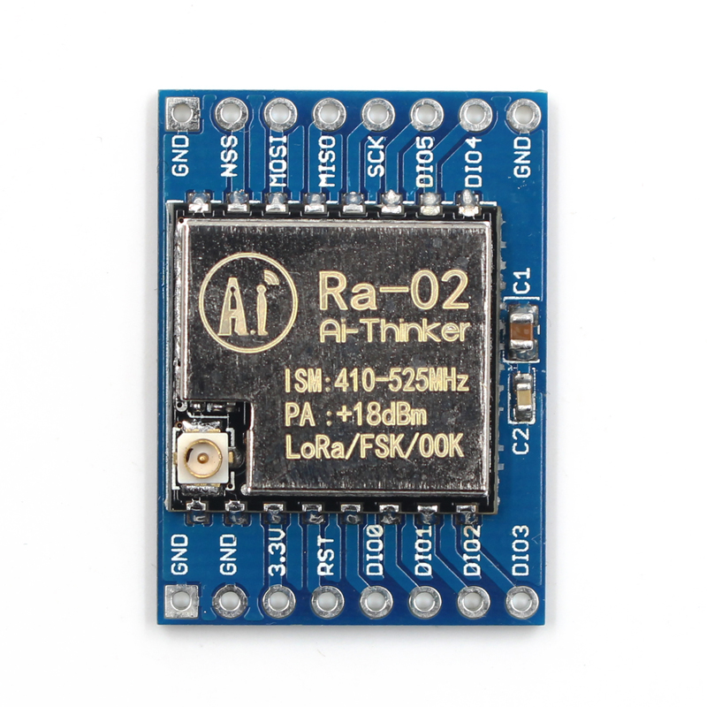
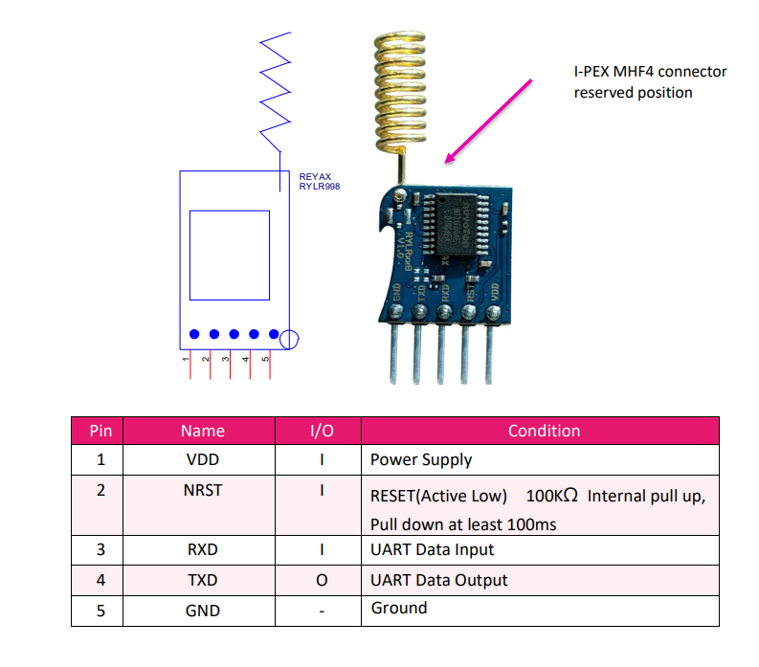
Hardware Implementation

Slide 18
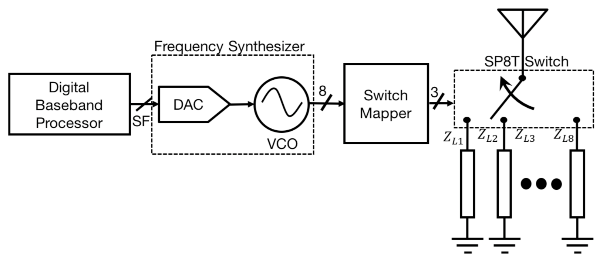
Hardware Implementation
Digital Baseband Processor sends the spreading factor (SF) to the DAC to be converted to an analog voltage
The DAC’s output controls the oscillation speed of the VCO
VCO’s output is mapped to used to select appropriate impedance

Slide 19
Hardware Implementation
Designed custom IC to minimize costs
Consists of three main components
Baseband Processor
Creates LoRa packet using SF, BW, and code rate
Sends packet data to Frequency Synthesizer to create the CSS signal
Uses 1.25𝜇W to make packet with SF=12, BW=3.25kHz, and an (8, 4) Hamming code

Slide 20
Hardware Implementation
Uses an extremely small amount of power
Other systems use complex analog components
Backscatter systems use switches to modulate reflections
Costs extremely cheap
IC costs proportional to size of chip
Active radio devices like for Wi-Fi, LoRa, BLE have about 10mm² die area used for RF components
Backscatter systems like RFID use about 0.15mm² of die area
This LoRa backscatter system uses <0.01mm² of die area
Switches use space efficient resistors and capacitors
Metal in metal capacitors made on metal layers on top of MOS structures
Notes:
Cheap because efficient use of space

Slide 21
Motivation
Design
Hardware Implementation
Results
Conclusion
References
Challenges & Future Work

Slide 22
Results Overview
Receiver Characterization
Operational Range
Wide-Area Applications
Whole-Home and Office Sensing
RF-Challenged Applications
Smart Contact Lens
Flexible Epidermal Patch Sensor
Notes:
(Blue)

Slide 23
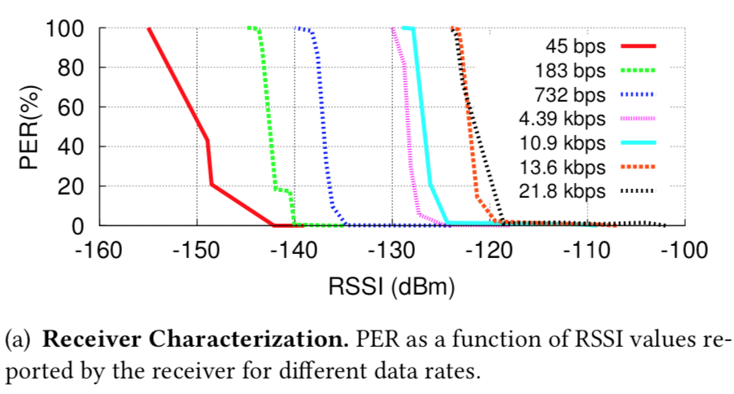
Receiver Characterization
Wired setup (avoid multipath complications)
Semtech SX1276 chipsets are both CSS transmitter and receiver
Conclusion: sensitivity is inversely proportional to the data rate of the packet
Below -142 dBm, receiver cannot correctly decode packets
RSSI values reported by chipset do not correspond to actual power level of received packet, but proportional
Notes:
(Blue)
PER = packet error rate
RSSI = received signal strength indication

Slide 24
Operational Range
Setup
SX1276 LoRa development kit with power amplifier as RF source
Transmitting 30 dBm signals in 6 dBi patch antenna at 915 MHz
Backscatter device to transmit LoRa packets at offset 3 MHz, SF=12, BW=31.25 kHz, (8,4) hamming code (3-byte payload, 2-byte CRC)
Two deployment scenarios
Notes:
Source transmitting at max power permitted by FCC on 900MHz ISM (instructional, scientific, medical) band

Slide 25
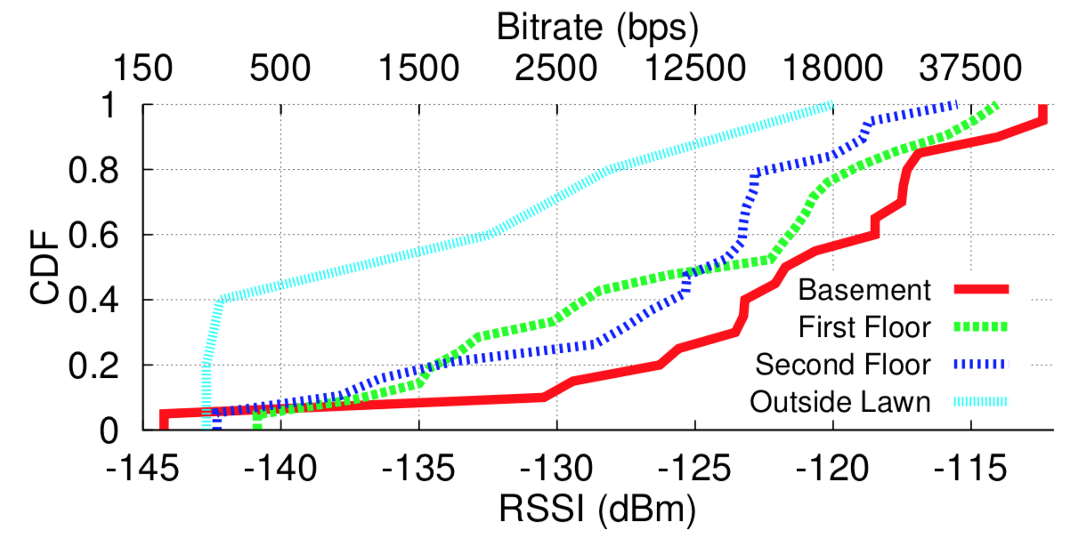
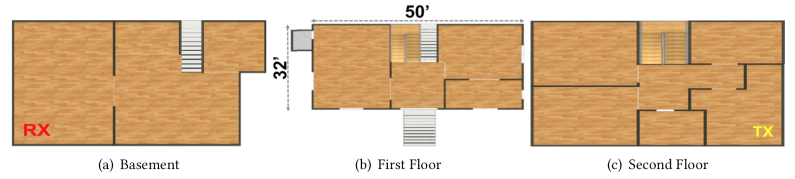
Applications: Whole-Home Sensing
Previously: limited range and coverage preclude whole-home sensing
LoRa backscattering deployment: 4,800 ft² three-story house (Δf = 1 MHz)
Backscattering device moved through house in 6x6-ft. grid
Conclusion: coverage is equivalent to typical wireless coverage; sufficient for smarthome IoT devices
Notes:
(Blue)
RSSI = received signal strength indication

Slide 26
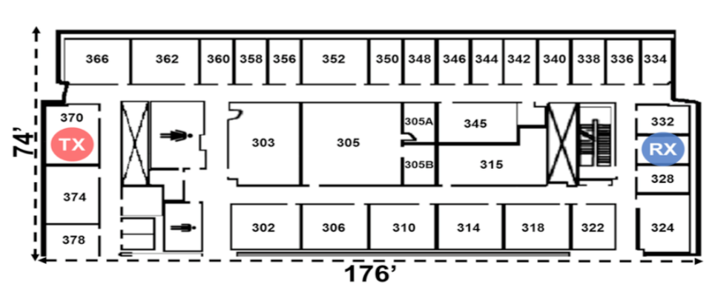
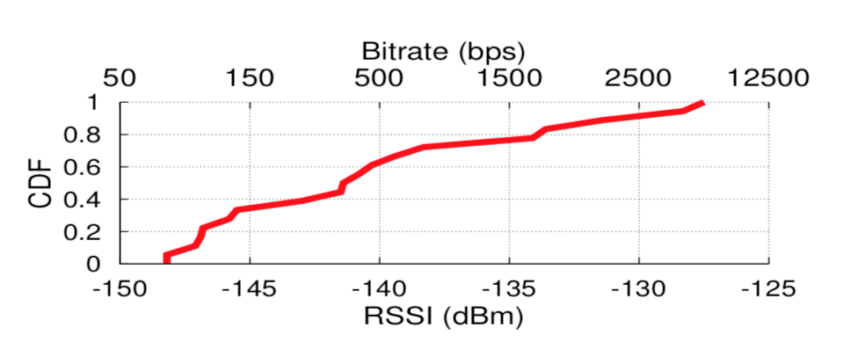
Applications: Office Sensing
LoRa backscattering deployment: 13,024 ft² office with 41 rooms (Δf = 3 MHz)
Backscattering device moved through office in 26x26-ft. grid; source and receiver have sheet-rock, metal, insulation, and offices between them
Conclusion: able to achieve wide-area backscatter coverage in significant multi-path environments
Notes:
(Blue)
RSSI = received signal strength indication

Slide 27
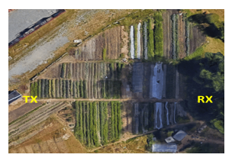
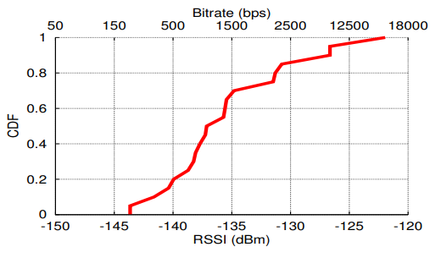
Applications: Precision Agriculture
Deployed on one-acre (~43560 ft²) farm
RF source and receiver on opposite sides
Farm divided into 45ft x 45ft grids
Backscatter device w/ 1MHz offset placed at ground level, between plants and bushes
RSSI measured across 20 locations at center of the grids
Median RSSI = -137 dBm, minimum RSSI = -143 dBm
Conclusion: reliable backscatter communication across a one-acre farm with only one transmitter and receiver
Notes:
CDF = cumulative distribution function (remember stats)

Slide 28
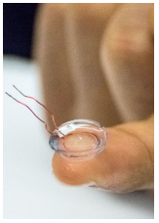
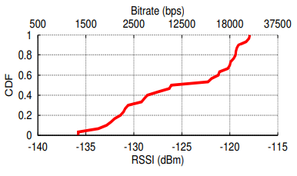
Applications: Smart Contact Lens
Can measure various health indicators (glucose, sodium, cholesterol) in tears
IC not currently possible to place in lens
1 cm diameter loop of 30 AWG wire between two contact lenses
Deployed in 104ft x 32ft atrium with RF source and receiver at opposite ends of the room
Driven by FPGA PoC and sends LoRa packets at 1MHz offset
RSSI measured at center of 12ft x 10ft grids in the room
Conclusion: smart contact lens can communicate via CSS backscatter at farther distances than prior approaches

Slide 29
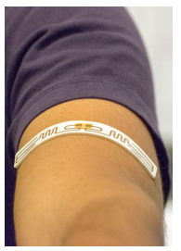
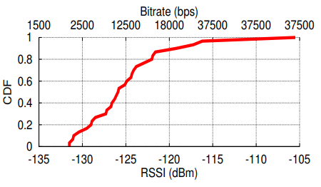
Applications: Epidermal Patch Sensor
Measure temperature, sweat, ECG, and other vitals in real time
Sticker RFID antenna (Alien’s Squiggle inlay) connected to FPGA PoC driver
Utilize cheap RFID tags with LoRa backscatter system to create cheap patch sensors
RF transmitter and receiver at opposite ends of 3,328 ft² atrium
Measuring RSSI of 1MHz offset backscatter signals just as the lens
Conclusion: patch sensor provides reliable connectivity with RSSI greater than -132 dBm
Notes:
ECG = electrocardiogram

Slide 30
Motivation
Design
Hardware Implementation
Results
Conclusion
References
Challenges & Future Work

Slide 31
Conclusion
LoRa is the first wireless system that operates at km distances while consuming less than 10 µW
Inexpensive, flexible form factor connectivity solutions which can be integrated into everyday objects
Feasible for wide-area deployment: whole-home coverage, precision agriculture, long-range medical implants, and more
Notes:
(Blue)

Slide 32
Motivation
Design
Hardware Implementation
Results
References
Challenges & Future Work

Slide 33
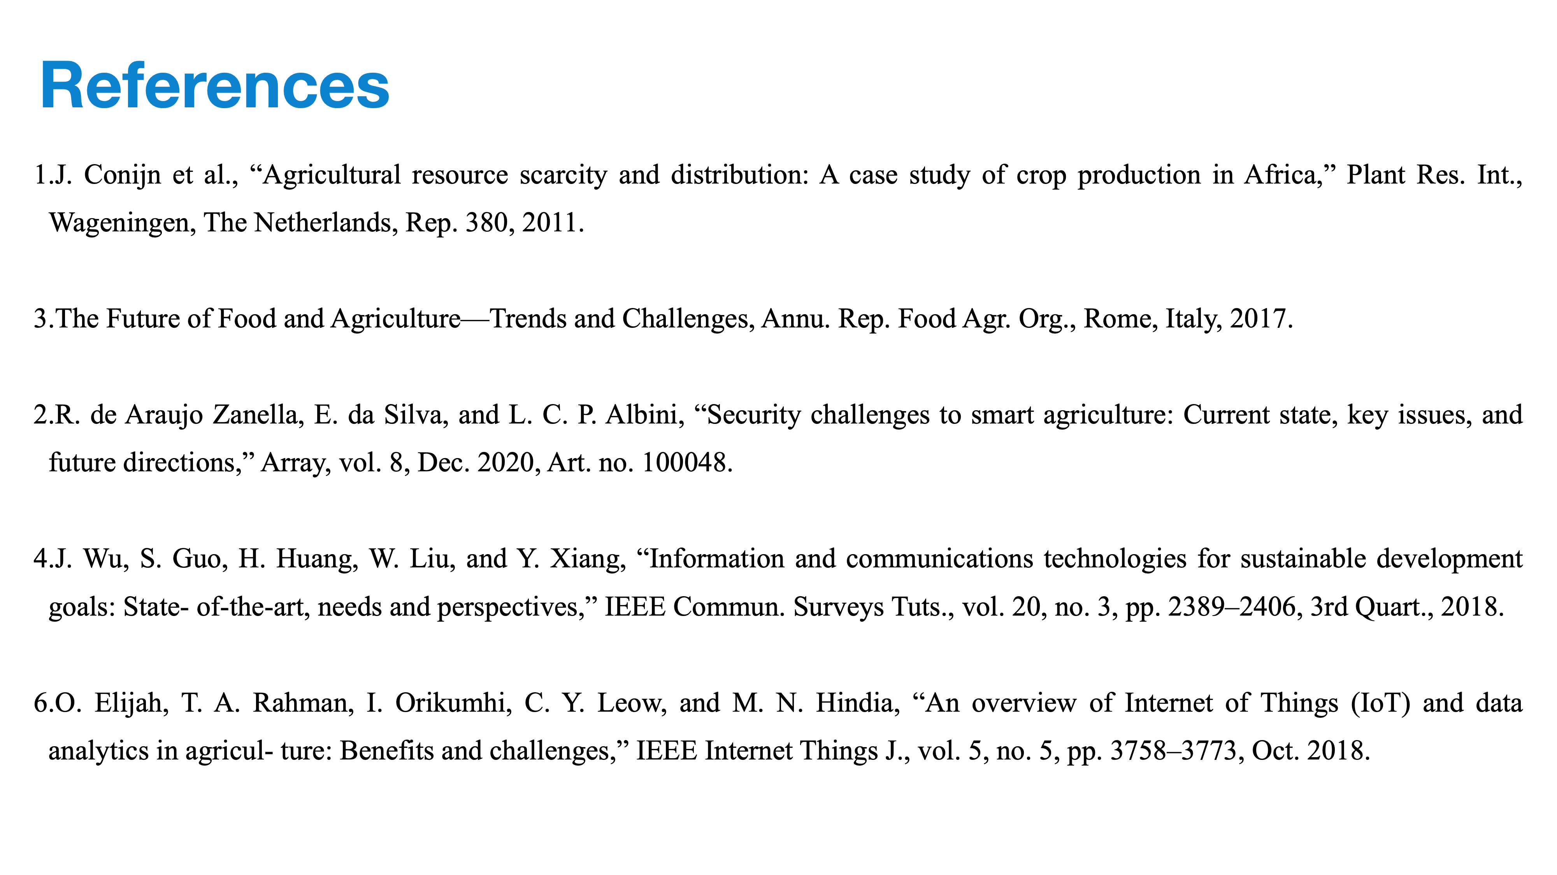
Achieving higher data rates
Currently limited by LoRa
Use multiple frequency bands or multiple antenna designs?
LoRa-independent design
Reliance on CSS modulation suggests key innovation is independent of LoRa
Networking high volumes of devices
Currently limited by TDMA’s upper bound on throughput
Other power sources
RF power harvesting?
Notes:
(Blue)

Slide 34
Questions?

Slide 35
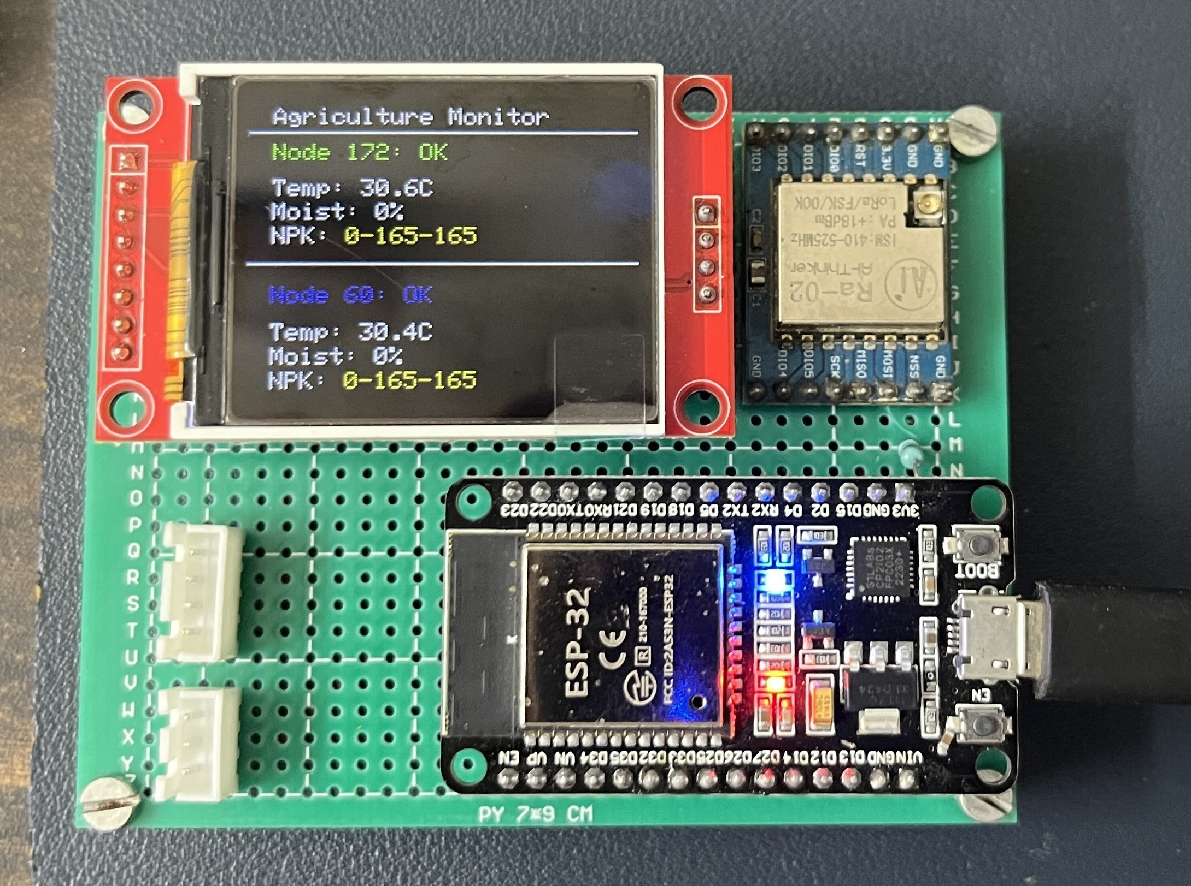
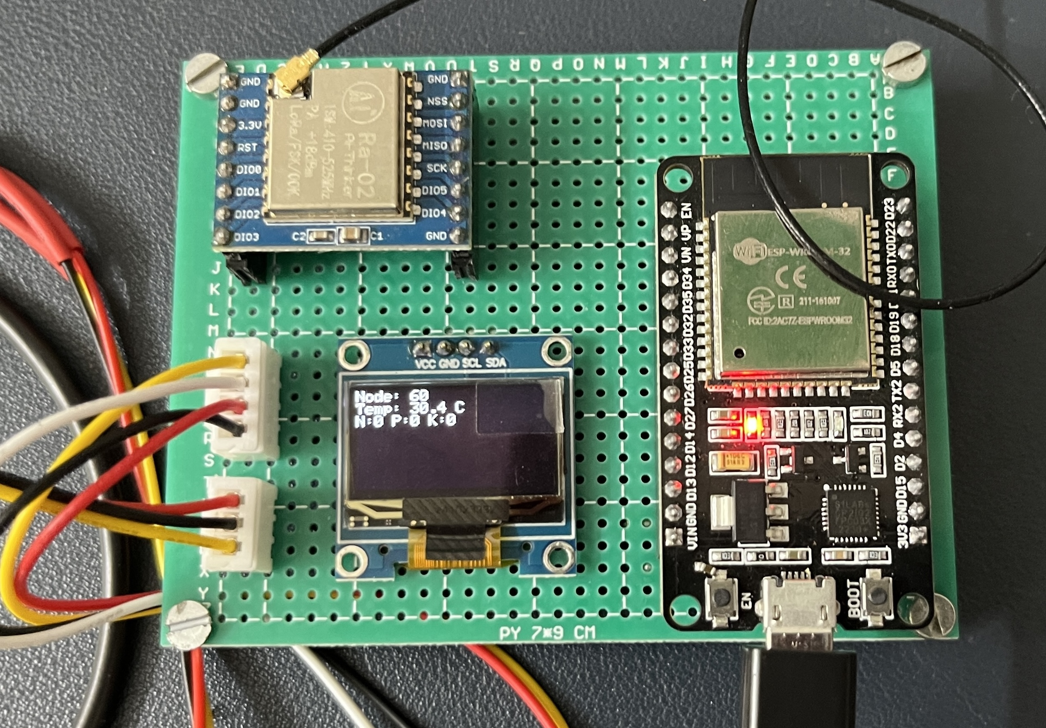
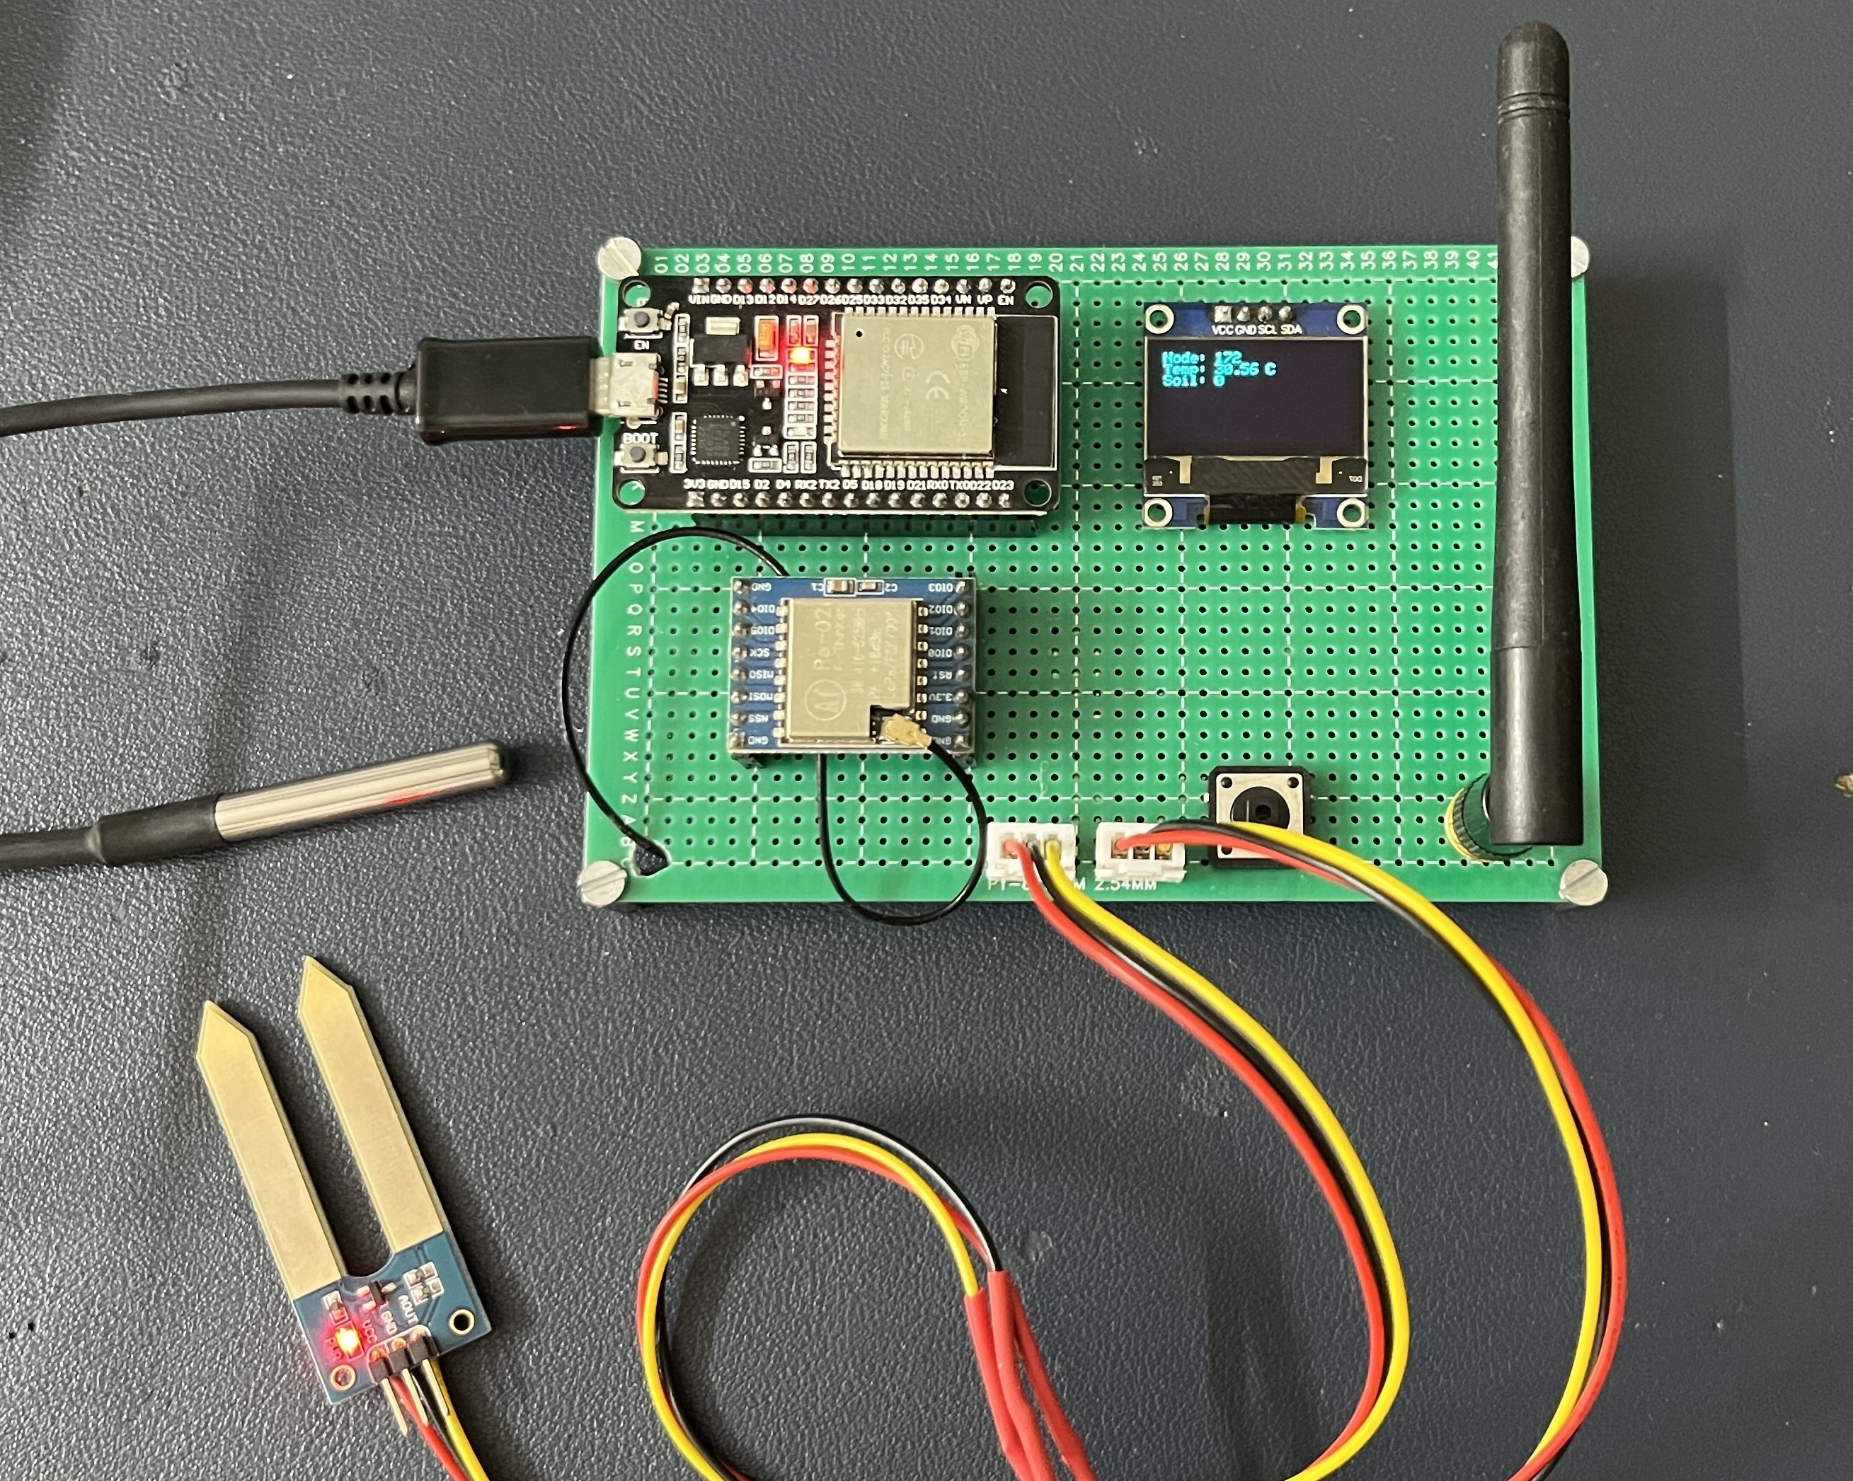
Receiver
NODE 1
NODE 2
https://github.com/PrateekSinghRajput/Post-Graduate-Project-Details-2025

